Slide 1
Gift Processing UC San Diego
UCSD Development Training
November 2015

Slide 2

Agenda
Introductions
Your unit and role
Desired outcomes of the training?
Tell us what you want to know!

Slide 3
Agenda
Overview of Definitions:
Gifts – components and tax deductibility
Grants and Contracts: what determines if an award is a gift, a grant, or a contract?
What are all the Rules and how can I know them all?
How do I process a gift?
Regents(campus) versus Foundation – which entity should the gift be made to and why?
How is a gift documented?
Why do we need a fund? And what are the types of gift funds?
Review and Acceptance
Payment
Gift recording, receipting and acknowledgement process
What happens to the gift once it is recorded in CRM?
How does a gift get expended? How do I find out if it has been used?
Planned gifts
Policy references and forms
Time and Interest Permitting:
Special events - special rules
What is “Private Support”? – Definition and reporting standards
Endowment – what is it and how does it work? Examples

Slide 4

Call Outs
Cheat Sheet

Slide 5
Definitions

Slide 6

So…What is a Charitable Gift?
LEGAL: A conveyance or transfer of an asset (including cash or negotiable instruments) given with charitable intent and without consideration.
Necessary components of a Charitable GIFT:
charitable intent
not an equal exchange (aka, not a business deal)
given irrevocably (not refundable ☺)
release of control
given to a legally recognized charity
HINT: All these things appear in a gift agreement!

Slide 7
WHAT MAKES A GIFT TAX DEDUCTIBLE?
Given to a bonafide charity recognized by the IRS
Cannot be given to an individual, and cannot be given to a charity and restricted to for an individual for personal benefit.
But it can be restricted for a specified charitable purpose, including a specific type of work (aka – done by a researcher)
Cannot be a “quid pro quo” transaction (an entirely even exchange of funds for results or services)
But, there can be a quid pro quo component, and that part will not be tax deductible ( more later)

Slide 8
What is a Grant?
Obligates the recipient to provide something or perform a service of more than incidental significance to the grantor.
Meaning???
Grants have “terms and conditions” such as reporting requirements, budgets, performance dates, return and expiration of funds, audit requirements, indemnifications, IP rights, etc.
BUT…If from a private source (ie..non government), the intention is still charitable, and the requirements are more of a detailed reporting nature within a time frame – so these will be counted as Private Support ☺!

Slide 9
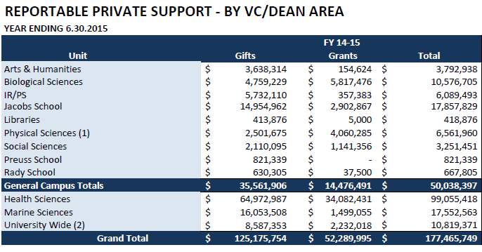

Slide 10
Private Grant Recording
Myth – If it is a grant, I can’t get credit as a Development Officer. Not true! YES you do get credit!
Private grants are received monthly by a report from OCGA.
We code and record them in the database so that the private support can be properly reported.
The office of acceptance is “Grant” and is listed under “category” on the Mill screen.
If you solicited the grant, you still need to put in opportunities so the credit is provided in ESP

Slide 11

Overarching Guidelines
UCOP Development Policy and Administration Manual
UCOP Policies and Delegations of Authority
UCSD Policy and Procedure Manual
UCSD Foundation Policies and Guidelines
CASE Management Reporting Standards
IRS Regulations
Other legal/ethical considerations
(many of these have references at the end)
Okay – so there is too much to know! Don’t be scared! We are here to help you!

Slide 12

Gift Processing Website
Have no fear…we also have a BLINK website!
http://blink.ucsd.edu/sponsor/gift-processing/list/

Slide 13
What is necessary to Process a Gift?

Slide 14
What Is Necessary to Process a Gift?
Cheat Sheet
Legal entity it is going to (Regents or Foundation?)
Documentation (letter or solicitation)
A Fund to put it in
Acceptance within UC Delegations of Authority
Payment (or delivery if a gift in kind)
Review/Entry/Allocation/Accounting

Slide 15
Legal Entity: UC Regents or UCSD Foundation?

Slide 16
Regents vs. Foundation??
Why are there two entities?
What’s the difference between the entities?
How do I select the right entity?
How are gifts processed to each?
SHORT ANSWER – Most often, the gifts are processed to the UC San Diego Foundation ☺

Slide 17
Two Legal Charities
Gifts that are solicited on behalf of UCSD belong to either of the following two legal entities:
The Regents of the University of California (95-6006144)
UC San Diego Foundation (95-2872494)
The UC Board of Regents are a governing Board of the system.
The Regents do have charitable status. Each campuses gift office may accept and process gifts on behalf of The Regents.

Slide 18
Campus Foundations
The individual campus foundations were established to provide a local Board and entity which could more effectively support the raising and management of funds for the unique needs of each campus.
Each campus has a foundation, governed uniformly by a single policy.
Most UC Development officers are charged with raising gifts to the campus foundations up and down the system.
But a gift can be made to EITHER entity!

Slide 19
How Do I Select the Charity?
General rule: Most development officers are soliciting gifts for the UC San Diego Foundation
HOWEVER – USE THE CHART and ensure your business officer has a say!
The Foundation is simpler for set up and processing.
But…the Foundation adds a layer of complexity in spending the gift. More on that when we talk about how gift funds are used.
Ask us for help if you need it !

Slide 20
GUIDELINES ON DIRECTING A DONOR’S GIFT TO THE REGENTS OR THE UC SAN DIEGO FOUNDATION There are various administrative and donor relations advantages to be considered in directing a donor’s gift. In particular, the UC San Diego Foundation is geared to handle high volume funds (many gifts solicited for the same purpose.), ongoing funds (those that will continue to receive gifts in the future) and endowed gifts. The Regents is primarily geared to handle individual one time gifts, particularly those for current expenditure. OF NOTE: Except for in-kind gifts to be held and retained by UCSD, any gift may be made to EITHER entity! OF NOTE: All gifts are counted for private support and credit to Development should be done regardless of the entity!
Cheat Sheet
The Regents
Previously established Regents Funds
One-time current use gifts (directed to a specific researcher and/or project)
Fellowships with a named Fellow and an application process: money really belongs to the Fellow
Gifts-in-kind to be held and retained by department and not sold – includes gifts of intellectual property rights
Real Estate to be held and used by UCSD
Bequests that do not specifically state “UC San Diego Foundation” or a Foundation fund
Any gift where a case cannot be made that the donor made an error and did not intend it to go to the Foundation
All items classified as Grants, Contracts, or Business Agreements
UC San Diego Foundation
Previously established Foundation Funds
Gifts made to funds that will be ongoing with a balance maintained over period of years
Annual funds and other higher volume gifts
Fundraising events managed by Development (gifts with quid pro quo)
Gifts-in-kind to be sold
Real estate for sale
Most planned/deferred gifts (Lead Trusts, Life Estates, Gift Annuities & Charitable Remainder Trusts)
Most endowed gifts
Most gifts for capital projects

Slide 21
Documentation
A gift or pledge letter from the donor, or a solicitation letter that was sent to many (documentation is required for all gifts over $10,000; otherwise encouraged)
Where do I get a gift letter sample and what does it need to contain? ON the Gift Processing Website!!
Samples are here: http://blink.ucsd.edu/sponsor/gift-processing/agreement-templates.html

Slide 22
What does the gift document need to contain?
Cheat Sheet
It should contain:
Statement : making an irrevocable gift ( intent)
Amount being given, or description of what is being given
If a pledge, terms of payment ( not to exceed five years)
Use/purpose of gift
Type of fund – expendable or endowed
What unit/area it benefit
Who will oversee the use
Yeah!!….no more gift fee disclosure!

Slide 23
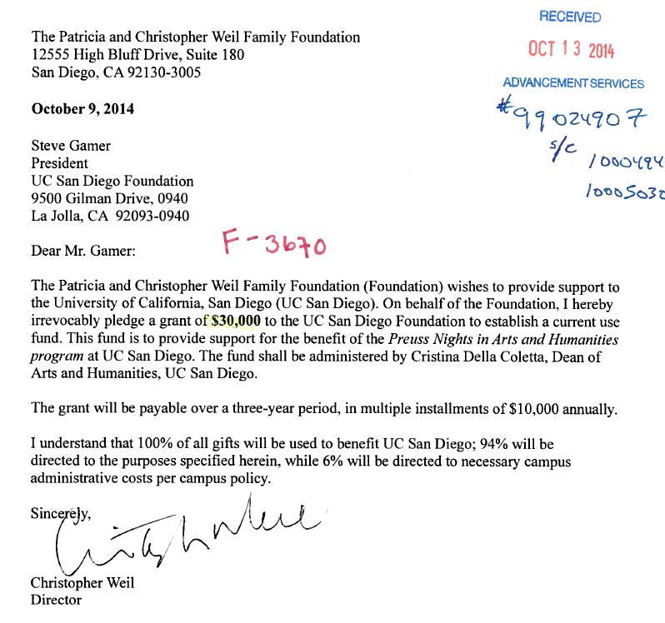

Slide 24
A Fund
A Fund is the “home” for the gift in terms of accounting for it. It’s like having a savings or checking account just for that gift purpose, or if equipment, just for those items
We need either a Regents or Foundation gift fund number the gift may be placed in, or a request for a new gift fund if needed
Fund Accounting rules = all gifts for a similar purpose may be allocated to the same fund
New funds are usually created only when a unique purpose cannot be attributed to an existing fund
Need a new fund info sheet for a Foundation gift?
http://foundation.ucsd.edu/accounting/foundation-forms.html
A Gift Acceptance Form for a Regents gift
http://blink.ucsd.edu/sponsor/gift-processing/forms.html

Slide 25
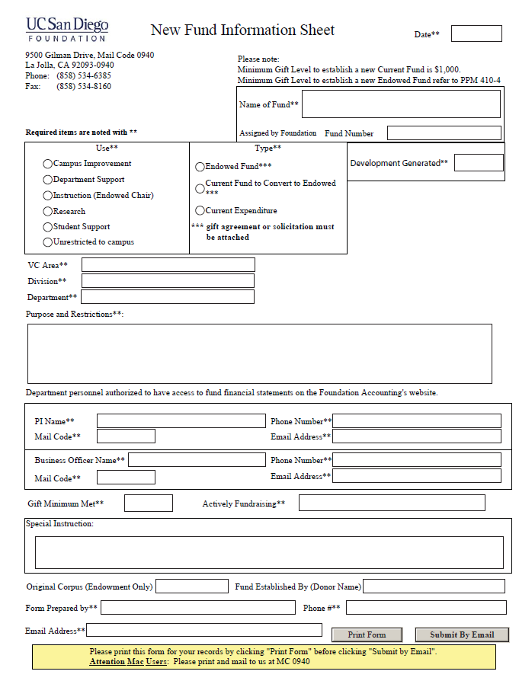

Slide 26
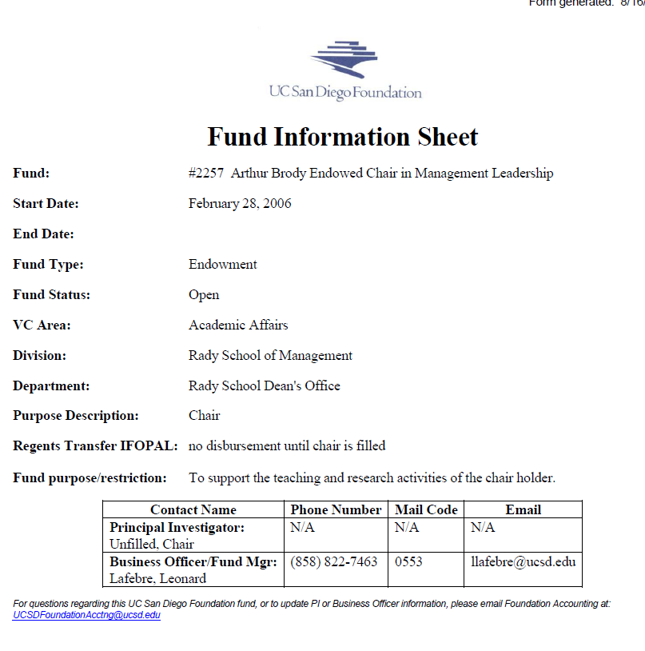

Slide 27
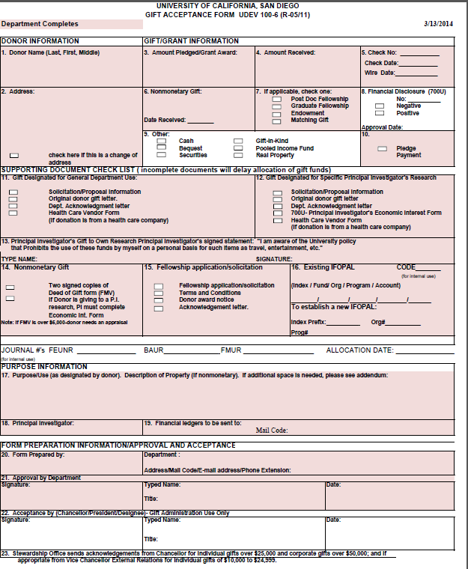

Slide 28
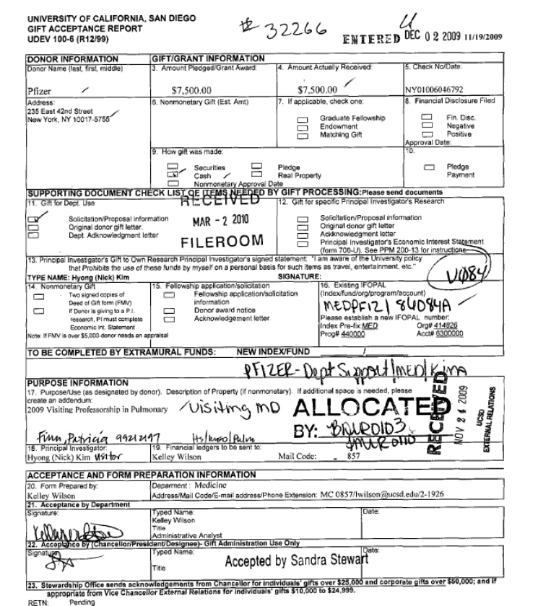

Slide 29
A Fund
Also must have proper “coding” in CRM as to:
Three Levels:
Level I – VC Area
Level II – Division if campus, Department if HS
Level III – Department if campus, Division if HS
Fund type: Endowed or Expendable
Purpose: Campus Improvement, Department Support, Instructional Support, Research, Student Support, Other Purposes/Unrestricted
The fund coding drives a lot of the private support reporting

Slide 30
FUND TYPES
Cheat Sheet
Current Funds: (Expendable)
Current funds are funds that are to be entirely expended for the purpose designated by the donor. Can be either the Regents or Foundation.
Once expended, the fund is closed
Current funds are not credited with interest earnings…earnings are swept
Endowed Funds: (Permanent)
Endowments are gift made to be held and invested in perpetuity:
The principal is never spent to ensure growth and long term funding Endowments require special gift language
Endowments can be held by either the Regents or Foundation
Endowment Spending Policies allow for spending some of the annual return This “spending” is then made available to the Departments
More on how endowment works at the end

Slide 31
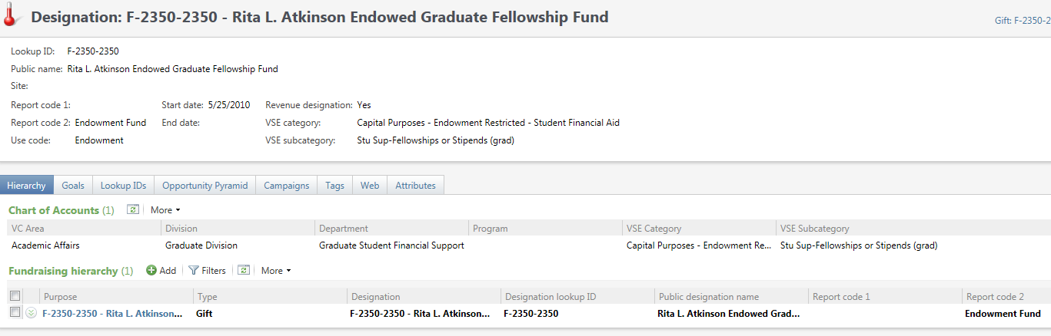
ESP CRM - Chart of Accts Example

Slide 32
Gift Acceptance
Delegation of Authority for Gift Acceptance Regents or Foundation Gifts
Over $5 Million: UC President
Up to $5 Million: Chancellor
Up to $1 Million: VC- Advancement
Up to $250,000: AVCs, Devel, Asst VC, Adv Services
Up to $100,000: Executive Director, Adv Services
Up to $25,000: Manager, Gift Processing
Faculty, development, or dept staff should NOT sign any documents to accept a gift.

Slide 33
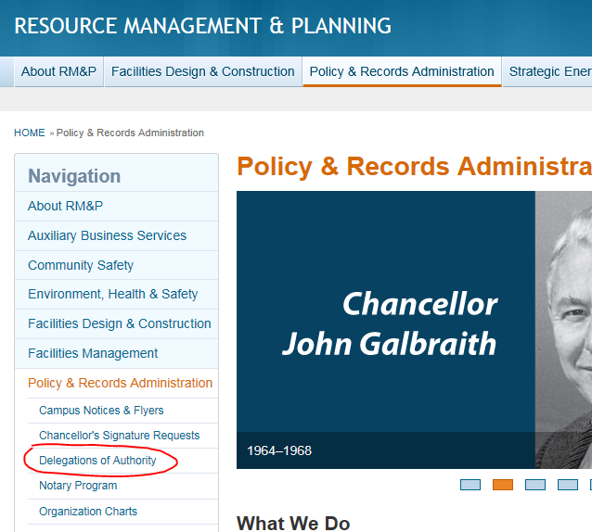
Gift Acceptance

Slide 34
Gift Acceptance
Gifts that must be approved and accepted by the President of the UC
Gifts over $5 million
Gifts requiring prominent namings of campus facilities, programs
Endowed chairs
Real property to be retained by UC

Slide 35
Payment Types/Delivery of Asset
What is the FORM of Gift and Payment and how are they processed?
Pledge only
Pledge payment or outright gifts
Check
Credit Card information
Stock gifts ( more)
Gifts in Kind (special rules and issues)
Deferred gifts and bequests – special processes and planned gifts

Slide 36
Gifts of Marketable Securities
A stock gift can be used to make an outright gift or a pledge payment.
Valuation date is the date they are received into our brokerage account (via DTC wire) or the properly endorsed certificates are delivered to UCSD.
Valuation amount is the average of the high and low price as published by the exchange on the date of the gift.
Donors are advised of how UCSD calculated the value of their securities gift; however, it is the donor’s obligation to determine valuation deducted for tax purposes.
Donor completes, signs & send with gift
GP Staff finalizes and submits for payment
Dept. Staff not authorized to sign
Anonymous gift
Request must be in writing
No information will be released to anyone
Gifts of Marketable Securities

Slide 37
Gifts in Kind
Gifts-in-Kind (tangible items) - must have a “related use” to UCSD; exceptions for appreciated property of securities and real estate
Usually valued at their fair market value less the discount for UCSD’s cost to purchase (if any)
Equipment gifts ( whether new or used):
Must have a department owner before they are accepted
Are documented using a gift letter or deed of gift form
For used for equipment – we need to ensure it is safe, and we often ask for help to determine the value from UCSD Procurement

Slide 38
Gifts in Kind
Free or reduced cost services are considered “Lost Income” and are not charitable gifts.
Only out-of-pocket costs related to providing these gifts may be deducted by the donor.
Out of pocket costs donors incur in hosting events for UCSD are deductible and we are happy to help document them.
Real estate gifts require a great deal of due diligence and are handled as a planned gift.
Gifts of art are tricky and not always desired. There is a POLICY! Talk to us first.

Slide 39
Gifts in Kind
If the FMV of a GIK is $5,000 or more, an individual donor will need a current appraisal (dated within 60 days of the gift date) and must submit an IRS Form 8283 with tax return.
Gifts-in-kind are receipted with a description of the gift only -- “value as declared by donor” is listed as the amount.
Donors are responsible for determining the deducted amount on their tax returns.

Slide 40
Review/Entry/Allocation/Accounting
Once a gift is received, whether a new outright gift, or a new pledge, or a pledge payment, and whether a gift to the Foundation or the Regents, in any form, UCSD Gift Processing performs the following:
Reviews the gift documentation to ensure it is a gift and determines acceptance criteria and routing if required
Codes all gifts to a fund; notes pledge payments, other items including non-deductibles, sol codes etc.
Batches all items for deposit or for credit card online entry and keying into ESP
Receipts and thanks donor
Scans back-up information
E-mail notifications go out the next day, to Development and to PI and BO

Slide 41
What happens to a Foundation gift once processed into the database?
Essentially, they ALL have to go into an accounting system
Foundation Accounting gets all the data and accounts for the transactions in the Foundation’s Fund Accounting system
Department owners access the information on the fund from their login on Advancement's STAR website

Slide 42
Foundation Gift Fund Process
Gift made to a UC SD Foundation Fund
Transfer Request
Funds Moved to a Regents Gift fund for Expenditure

Slide 43
Spending a Foundation Gift
The Foundation fund works like a savings account
Departments request use of Foundation funds by lump sum transfers to the University
The transferred funds are placed in a University transfer fund by Foundation accounting personnel
Departmental personnel then expend the funds in the same manner as other University funds (see below)
The University transfer fund works like a check book

Slide 44
How is a Gift Expended Once in UCSD?
Gifts may be spent only from University ledgers in accordance with the gift purposed and all the normal ways to expend all University funds. For example….
Purchase order/equipment
Payroll costs
Awards, stipends for students
Reimbursements
Check request
Travel

Slide 45
What happens to a Regents Gift once processed?
Gift Processing prepares a journal entry to allocate the gift and record the gift revenue in the University’s Fund Accounting system
If a gift in kind provides the data to general accounting for recording
Scan or file back-up information
E-mail notification to PI or BO
Note: Only after a gift is allocated will the gift show up on the Department ledger so that it can be used.

Slide 46
Regents Gift Fund Process
Gift Placed Directly in a Regents fund for expenditure

Slide 47
How is a Gift Expended Once in UCSD?
Gifts may be spent only from University ledgers in accordance with the gift purposed and all the normal ways to expend all University funds. For example….
Purchase order/equipment
Payroll costs
Awards, stipends for students
Reimbursements
Check request
Travel

Slide 48
How Will I Know if a Gift is Expended?
How will you know if the money is spent?
You can use Advancement's STAR website which you access through Cognos. (Example fund 4524)
Also, develop a relationship with business officers in units.
It is ONLY by expenditure of the gift ( if current use) or of the endowment payout (if endowment) that YOU have a good stewardship story!!
Otherwise, you may end up with an upset donor at some point.
Make SURE the gifts you raise get used!! Followup!

Slide 49
Planned Gifts
Planned Gifts – Many types – contact OPG
UCSD Foundation and the UC Regents both accept charitable trusts and will act as trustee, and both have Charitable Gift Annuity licenses from the State of CA.
Bequest intentions are not counted in annual private support totals ( Regents or CAE), but may be countable in a campaign

Slide 50
POLICIES and REFERENCES

Slide 51
Forms
Foundation Fund Information Sheet, Signature Authorization
http://foundation.ucsd.edu/accounting/foundation-forms.html
Regents Gift Acceptance Form
http://blink.ucsd.edu/sponsor/gift-processing/forms.html

Slide 52
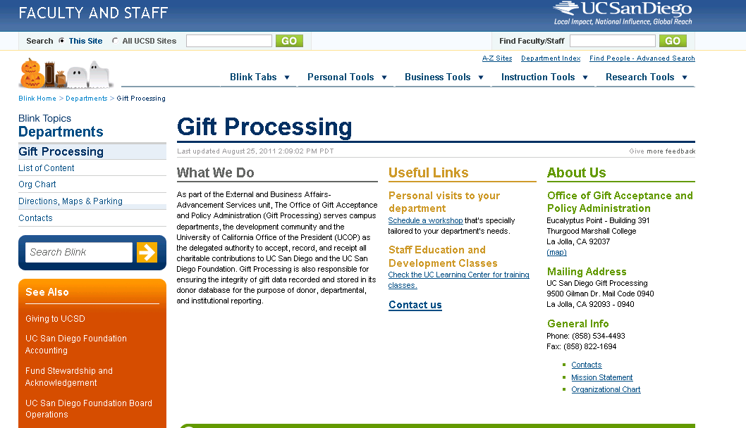
GIFT PROCESSING BLINK SITE
http://blink.ucsd.edu/sponsor/gift-processing/index.html

Slide 53
Other Policy References
UC Development Policy and Administration
http://www.ucop.edu/institutional-advancement/policies-and-guidelines/index.html
UCSD Gift Processing Manual http://blink.ucsd.edu/sponsor/gift-processing/list/index.html
Classification of Awards from Private Sources PPM 150-35
UCSD Naming Policy – PPM 410-4
UCSD Endowment Minimums - PPM 410-30
UCSD Endowed Chair Policy – PPM 230-8
UCOP Resources http://www.ucop.edu/institutional-advancement/

Slide 54
Special Events – Special Rules

Slide 55
Event Tickets
Often have a Quid pro quo component– defined as “value received” (get what you pay for)
IRS rules: the charity is responsible to specifically disclose, at the time of solicitation, the fair market value (FMV) of any benefits a donor receives in exchange for a gift.
Special events are notorious for this: meals, entertainment, drink, valet, music, etc.
The cost to the charity of providing these items to the charity is not necessarily a measure of FMV, especially if the costs were underwritten.
The charity must disclose the FMV of the benefits at the time of solicitation, which is not a tax deductible gift!!!!

Slide 56
HOW TO DISCLOSE “quid pro quo?”
How do I value “quids”?
Look up fair market values on public venues
For example:
Hotel rooms – standard published rates
Meals – what would you pay in a restaurant?
An “evening” out – what would that cost?
Perks – like give away packages – what would it cost to buy it?
NOTE: OUR COST may not be FMV!
Disclosure examples:
“$_____ of your payment is tax deductible; $_____ represents the estimated fair market value of the benefits provided.” or
“tax deductible amount is $____________”

Slide 57
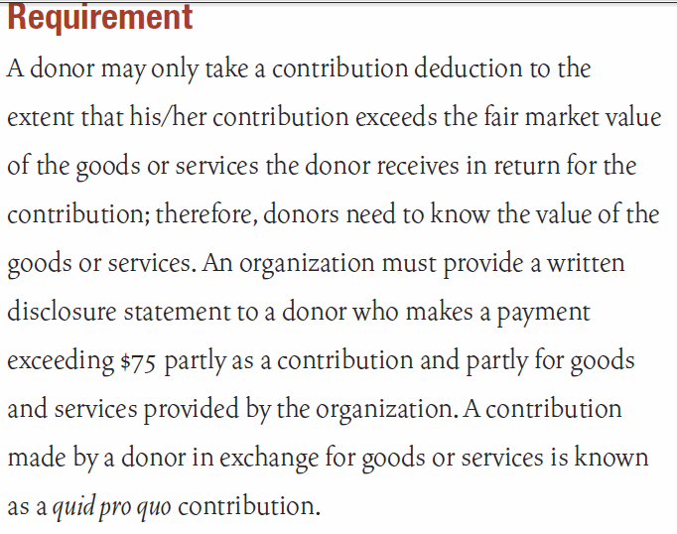
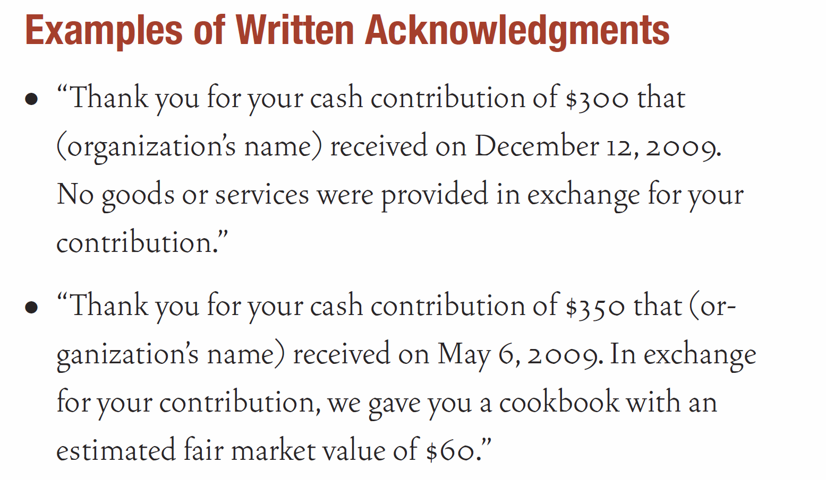
IRS Disclosure Regs and Example

Slide 58
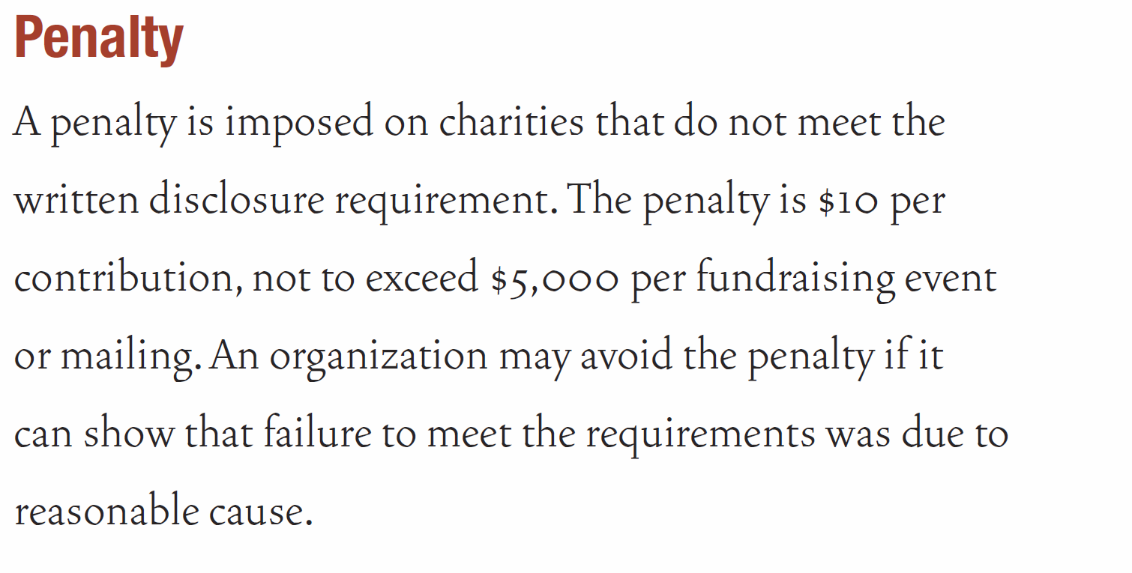
IRS Penalties

Slide 59
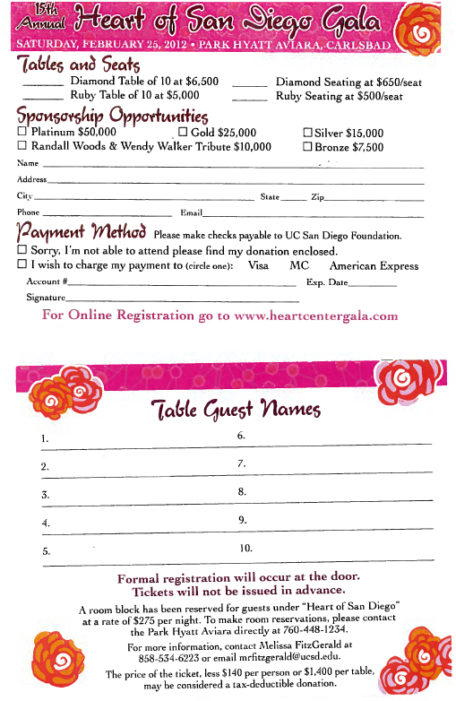
UCSD Ticket/Table Disclosure Example
“The price of each ticket, less
$140, or $1400 per table, is tax
deductible as a charitable
donation”
Or:
“$140 per ticket, or $1400 per
table, represents the value of
the benefits received; the
balance is a charitable gift”

Slide 60
Raffles
RAFFLES are regulated by the State of California.
Charitable raffles are now permitted, via a registration process. http://ag.ca.gov/charities/raffles.php
Yes, EVERY raffle has to be registered through our office.
90% of all raffle proceeds must go to the charity.
That means – no 50/50 raffles, or any other use of the proceeds from the raffle as the prize.
The ticket sales are not a charitable donation, as they represent the purchase of a chance to win, or 100% quid pro quo. They also can NOT be sold online!
Oh yes – and, certain winning values require IRS 1099’s to the winners.
Make certain we are aware of these so we can give you all you need!

Slide 61
Auctions
Auctions involve a good amount of organization and paper trail. They have two components:
Incoming gifts in kind from donors (the items to be auctioned off):
Some items are recorded and receipted as gifts, such as tangible personal property
Other items, such as free services, free uses of facilities or homes etc, are lost income and are not receipted or recorded, but are still accepted for auction
All should be acknowledged

Slide 62
Auctions, cont.
Sale of the Items at Auction:
Must be listed with a fair market value at the auction with written disclosures related to the amount that will qualify as a tax deductible gift if purchased.
Anything paid under or at FMV is quid pro quo, meaning, no gift and no tax deductibility
Anything paid in excess of FMV is receipted as a gift and tax deductible.

Slide 63
Sponsorships
SPONSORSHIP
Sponsorships come in two forms:
where commercially valuable benefits such as advertising of the sponsor and their products are returned to a sponsor by the donee entity, the sponsorship is considered business income to the donee entity and advertising or marketing expense to the sponsor (that is, not a gift).
Such income may be subject to Unrelated Business Income Tax (UBIT) by the donee.

Slide 64
Sponsorships
SPONSORSHIP (cont’d)
Where only incidental benefits are returned to a sponsor by the donee entity, such as use of the sponsor’s name or logo for donor acknowledgment, and when less than 2% the sponsorship paid is returned in value of goods or services to the sponsor, then the sponsorship is a “qualified sponsorship” to the donee entity, is not subject to UBIT, and is a defined as a GIFT under University policy and IRS regulations.
Most of our Development-related events have sponsorships that would be defined as a gift. They are……….

Slide 65
Underwriting
EVENT UNDERWRITING
Generally a gift provided to assist UCSD in putting on an event.
Underwriting is solicited often at UCSD and is treated as a charitable gift, as long as the benefits returned to the sponsor fall under the 2% rule.
Some benefits, in the form of event tickets, etc, may be provided in return to the underwriter, as quid pro quo, and will be receipted accordingly.

Slide 66

What is Private Support?
PRIVATE SUPPORT is defined by
CASE Management Reporting Standards)
Private support is:
All gifts and private grants provided by private (non- governmental) entities in support of educational, research and outreach missions

Slide 67
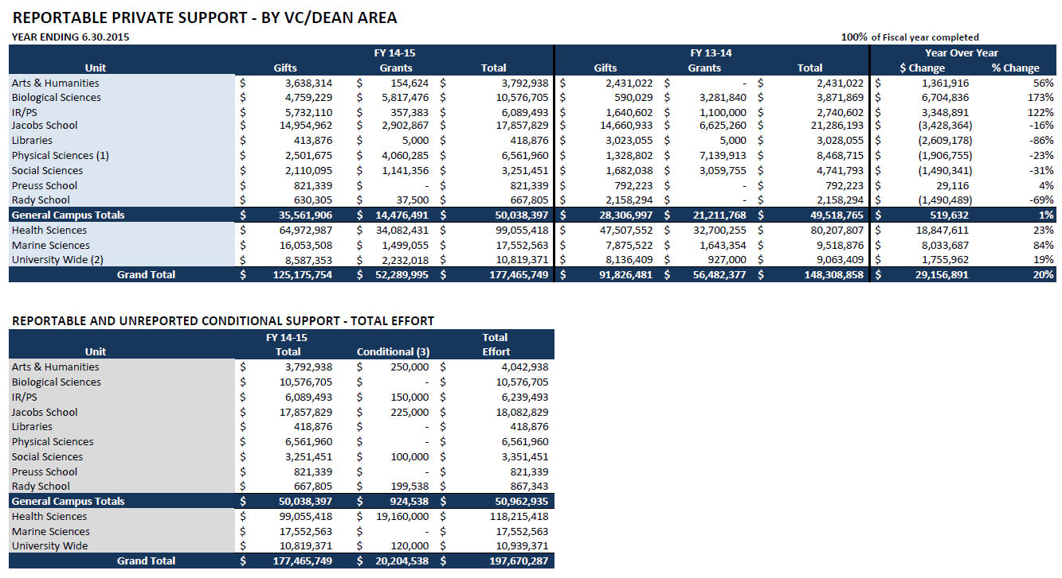

Slide 68
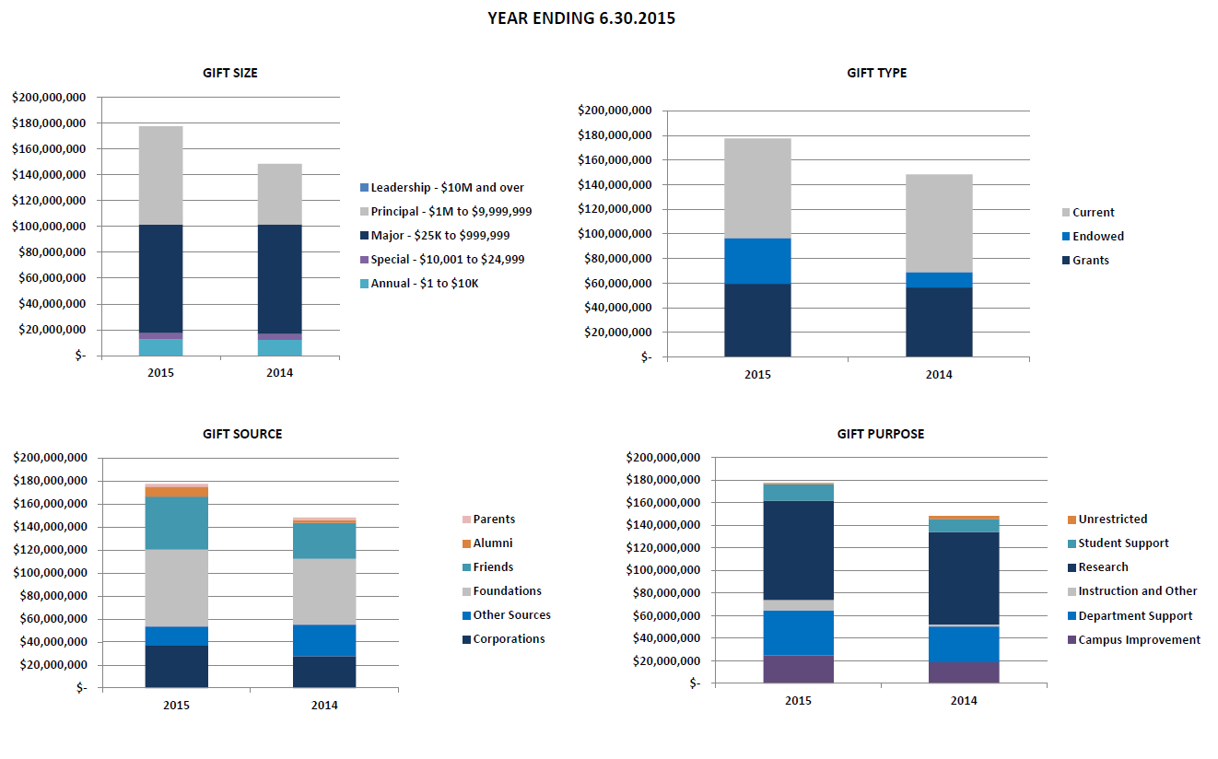

Slide 69
Private Support Reporting- Example
Pledge in year 1 for $10M; paid over 5 years
Gift in kind of equipment valued at $100,000 per year
Annual fund gifts of $50,000 per year
(Five year total is $10,750,000)
Regents Convention:
Year 1 Year 2 Year 3 Year 4 Year 5
$10,150,000 $150,000 $150,000 $150,000 $150,000
CAE Convention:
Year 1 Year 2 Year 3 Year 4 Year 5
$2,150,000 $2,150,000 $2,150,000 $2,150,000 $2,150,000

Slide 70
Endowment
A gift given whereby the original gift is not to be expended.
It is to be invested, generally with the objective to grow the principal over time by investment returns.
Generally invested in diversified portfolios of stocks, fixed income and alternative investments that produce both cash returns of interest and dividends and return in the form of unrealized appreciation (or depreciation, as the case may be!)

Slide 71
Endowment
If the gift cannot be spent, what good then, is the gift?
The idea is that a portion of the annual investment returns will be used for expenditure. This is called the “endowment spending policy”. It is set by the policy of the governing board.
The unexpended amount of return is retained in the principal, helping to protect it from inflation and thus protect the future “spending streams”.

Slide 72
Endowment
Put another way: Grow the principal, grow the spending. Purchasing power hopefully stays the same, or improves, over time.
The fund lasts forever, done right. Permanent money is the best kind to have!
But yes, a large endowment is needed to produce any reasonably sized spending stream.

Slide 73
How Do Investment Return and Payout Calculations Really Work?
Take the example of a new endowed gift of $106,000 on July 1 2013
$6,000 is taken out for the gift fee
$100,000 “buys into” the endowment pool
Buy in is based on the month end value of a single unit in the pool.
Assume the pool has 10,000,000 units and the value of a unit is $4.00 on June 30, 2013
This gift would buy $100,000/$4 or 25,000 units
The pool would now have 10,025,000 units in it.
Assume the five year average value of a single unit in the pool is now $3.95

Slide 74
Investment Returns
Now lets say that the endowment pool is invested in 80% equities and 20% fixed income.
The overall pool value is $40,000,000 to begin with.
The pool earns the following in returns during the next 12 months:
Cash return
$40M * 20% * 4% interest $ 320,000 fixed income cash return
$40M * 80% * 1% dividends $ 320,000 equities cash return
$ 640,000 1.6% cash return
Appreciation return
$40M * 20% * 0% $ 0 fixed income appreciation
$40M * 80% * 9% $2,880,000 equities appreciation
$2,880,000 7.2% appreciation return
Total Return $3,520,000 8.8% overall return
New Market Value $43,520,000 Before payout

Slide 75
Calculation of Payout
Calculation of overall fund payout:
10,025,000 units X 4.75% X $3.95 5 year avg value of a unit = $1,880,940 in payout.
Calculation of new fund market value:
New ending market value of the pool overall is $43,520,000 less $1,880,940 in payout = $41,639,060 or $4.153 per unit.
For the new endowment:
Payout
25,000 units X 4.75% X $3.95 5 year avg value of a unit = $4,690 in payout
Market Value
New market value of the fund = 25,000 units * $4.153/unit = $103,825

Slide 76
Our new fund:

Slide 77
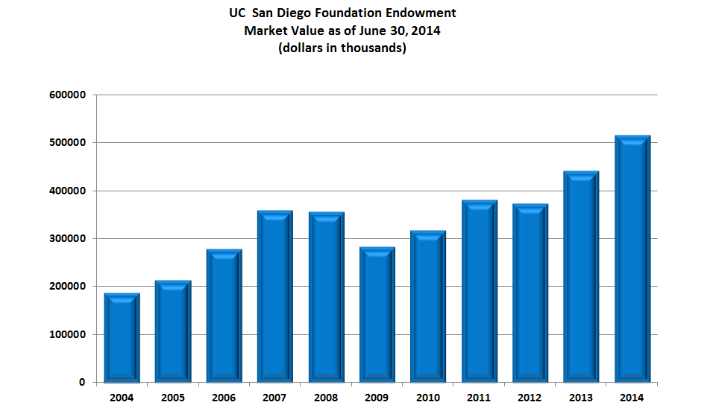

Slide 78


Slide 79
Thank you!!

